Slide 1
Crop Production Analysis in India
K.R.POORNIMA

Slide 2
Problem Statement:
The Agriculture business domain, as a vital part of the overall supply chain, is
expected to highly evolve in the upcoming years via the developments, which are taking place on the side of the Future Internet. This paper presents a novel Business-to-Business collaboration platform from the agri-food sector perspective, which aims to facilitate the collaboration of numerous stakeholders belonging to associated business domains, in an effective and flexible manner.

Slide 3
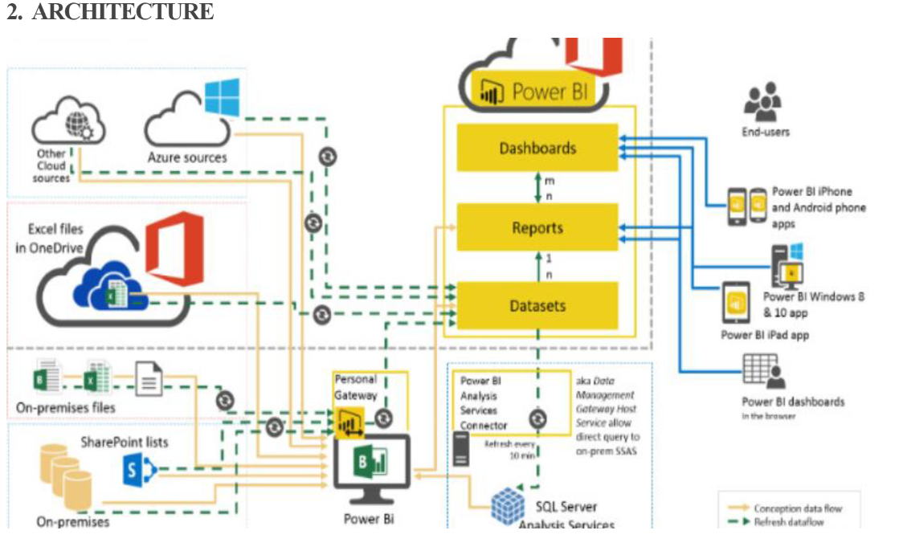

Slide 4
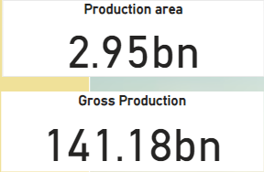
INSIGHTS
Total Production area is 2.95bn.
Gross production for the 1997-2015 is 141.18bn

Slide 5
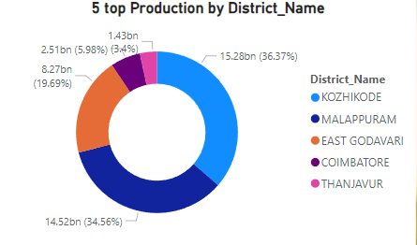
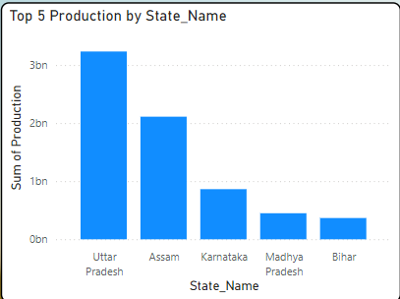
Kozhikode, Malappuram, East Godavari, Coimbatore, Thanjavur are the 5 top producing districts
Uttar Pradesh, Assam ,Karnataka , Madhya Pradesh, Bihar are the top 5 productuib by state.

Slide 6
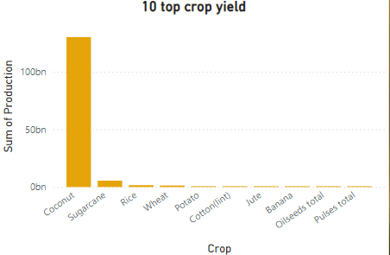
Top crops yields are
Coconut
Sugarcane
Rice
Wheat
Potato
cotton

Slide 7
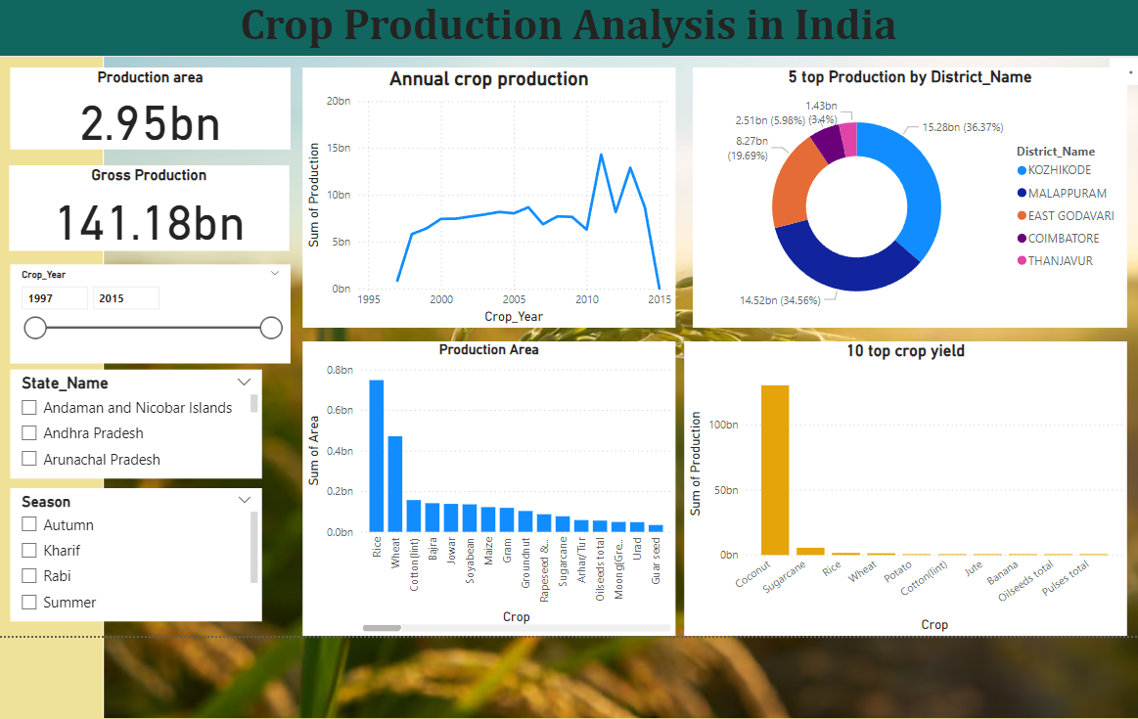
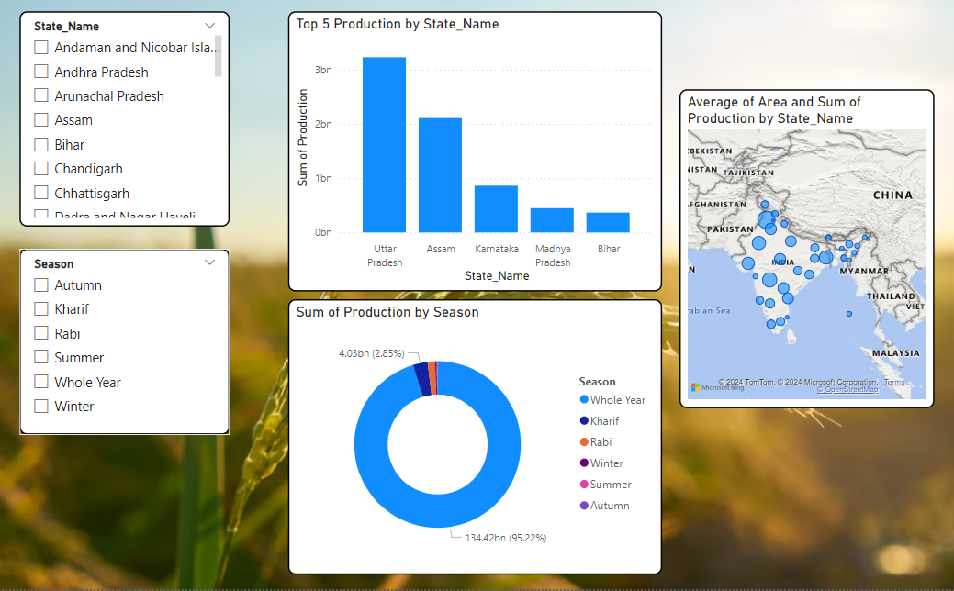
Coconut is having highest production in India.

